Slide 1
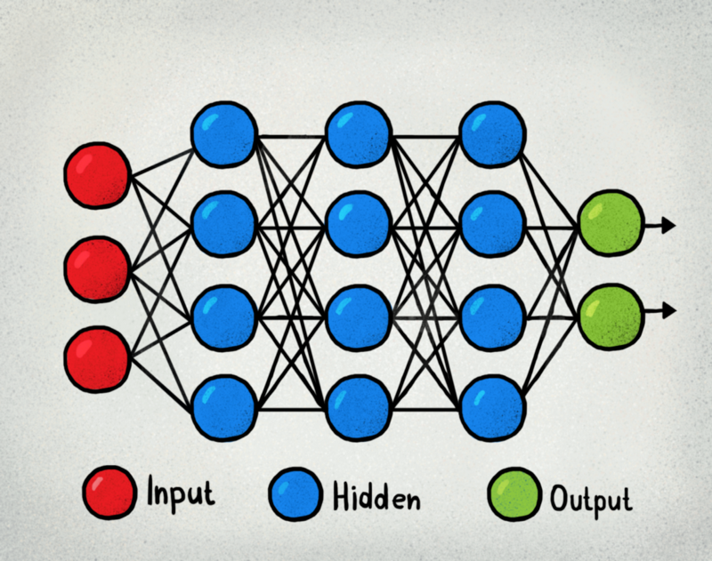

CSE 3521: Neural Networks
OR

Slide 2
Today
Overview
Feedforward neural network
Recurrent neural network
Perceptron
Multi-layer Perceptron (MLP)

Slide 3
Overview of Neural Networks
Which one?
OR

Slide 4
Overview of Neural Networks
Feed-forward neural network

Slide 5
Overview of Neural Networks
Image
Cat score
Dog score

Slide 6

Overview of Neural Networks
Cat score
0.1
0.9
Dog score

Slide 7

Overview of Neural Networks
Cat score
0.9
0.1
Dog score

Slide 8

Overview of Neural Networks

Slide 9
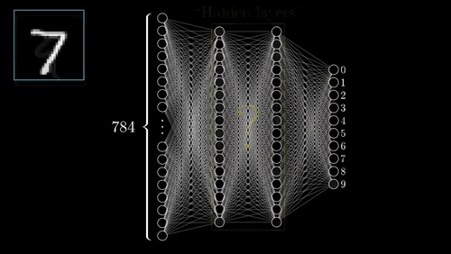
Overview of Neural Networks

Slide 10

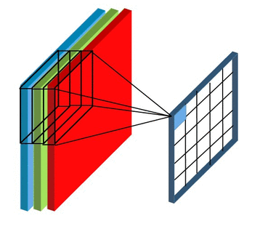
Convolutional Neural Networks
A current node is not directly affected by “all nodes in the previous layer”
The network “weights” on the edges can be “re-used”

Slide 11
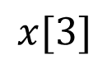
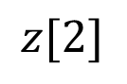
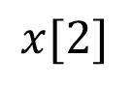
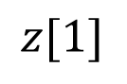
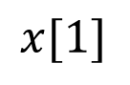
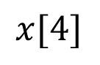
Convolutional Neural Networks
A current node is not directly affected by “all nodes in the previous layer”
The network “weights” on the edges can be “re-used”
$$x[1]$$
$$x[2]$$
$$z[1]$$
$$x[3]$$
$$z[2]$$
$$x[4]$$

Slide 12
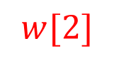
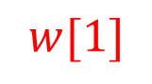
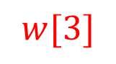
Convolutional Neural Networks
A current node is not directly affected by “all nodes in the previous layer”
The network “weights” on the edges can be “re-used”
$$x[1]$$
$$w[1]$$
$$w[2]$$
$$x[2]$$
$$z[1]$$
$$w[3]$$
$$x[3]$$
$$z[2]$$
$$x[4]$$

Slide 13
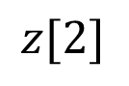
Convolutional Neural Networks
A current node is not directly affected by “all nodes in the previous layer”
The network “weights” on the edges can be “re-used”
$$x[1]$$
$$x[2]$$
$$w[1]$$
$$z[1]$$
$$w[2]$$
$$x[3]$$
$$z[2]$$
$$w[3]$$
$$x[4]$$

Slide 14
Convolutional Neural Networks
“Local patterns” can show up at different image locations
Top-left, Top right: has ears
Middle: has eyes

Slide 15
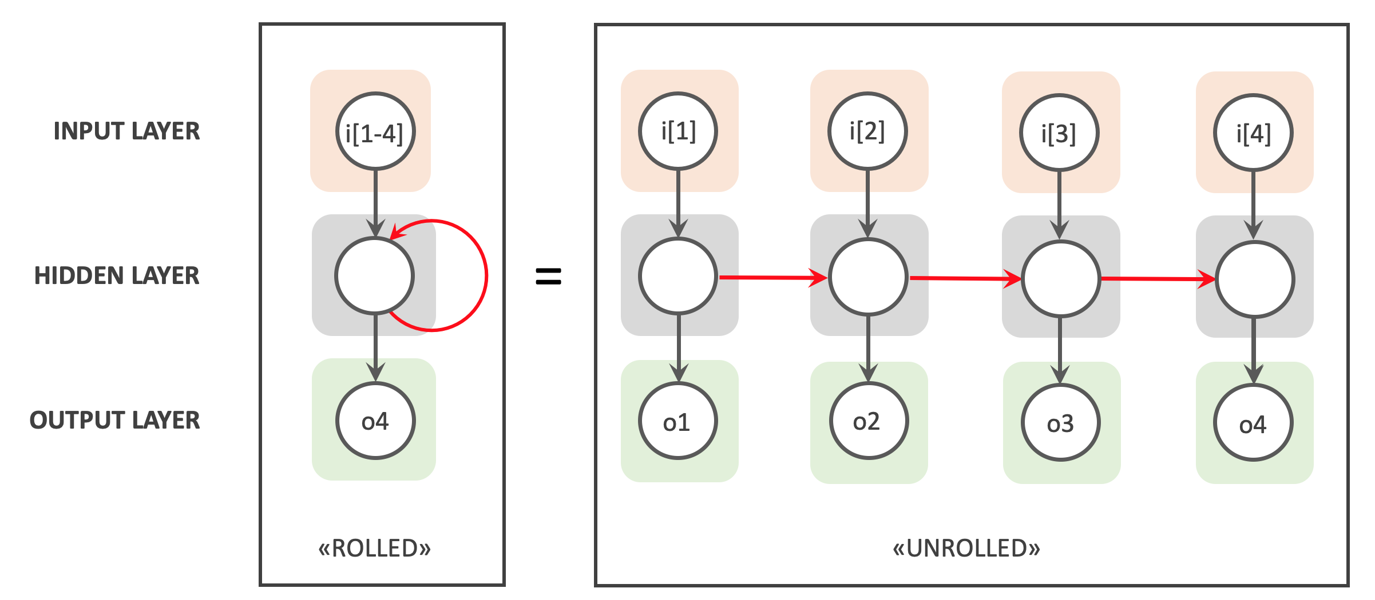
Recurrent Neural Network
Other styles: Recurrent neural network

Slide 16

Recurrent Neural Network

Slide 17
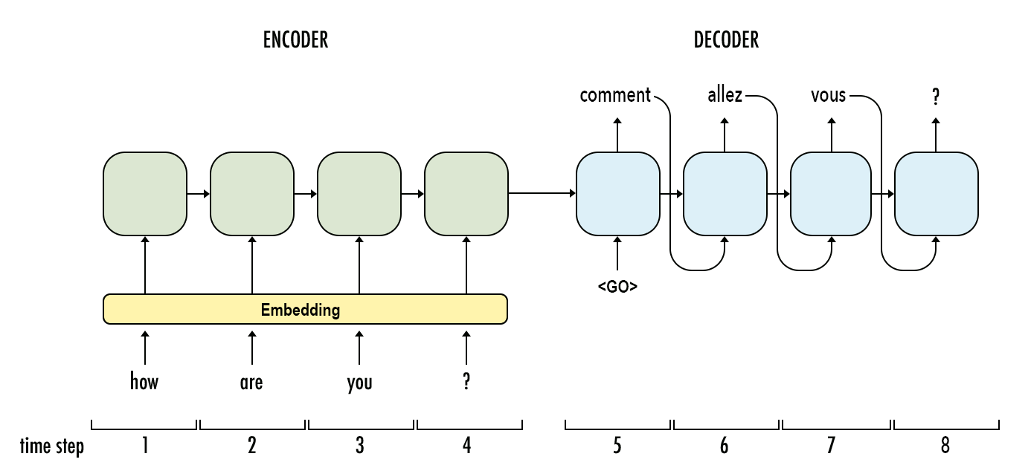
Recurrent Neural Network

Slide 18
Today
Overview
Feedforward neural network
Recurrent neural network
Perceptron
Multi-layer Perceptron (MLP)

Slide 19
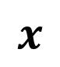
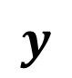
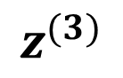
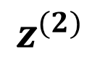
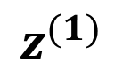
“Artificial” Neuron
A basic “computational unit” of neural networks
$$x$$
$$z^{(1)}$$
$$z^{(2)}$$
$$z^{(3)}$$
$$y$$

Slide 20
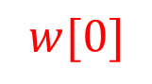
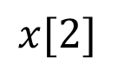

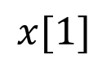
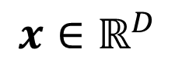
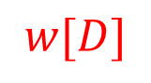

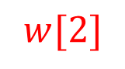
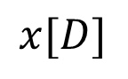

Perceptron (single neural for classification)
Learnable weights
$$1$$
$$w[0]$$
$$x[1]$$
$$w[1]$$
Input
$$w[2]$$
$$Σ$$
Output
$$x∈ℝ^{D}$$
$$x[2]$$
$$w[D]$$
…
Weighted
Sum
Step (sign)
$$x[D]$$

Slide 21
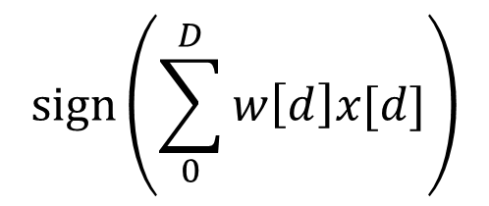
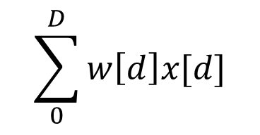
Perceptron (single neural for classification)
Learnable weights
$$1$$
$$\sum_{0}^{D}{w\left[d\right]x[d]}$$
$$sign\left(\sum_{0}^{D}{w\left[d\right]x[d]}\right)$$
$$w[0]$$
$$x[1]$$
$$w[1]$$
Input
$$w[2]$$
$$Σ$$
Output
$$x∈ℝ^{D}$$
$$x[2]$$
$$w[D]$$
…
Weighted
Sum
Step (sign)
$$x[D]$$

Slide 22


Perceptron (single neural for classification)
Learnable weights
$$1$$
$$w[0]$$
$$w^{T}x+b$$
$$sign\left(w^{T}x+b\right)$$
$$x[1]$$
$$w[1]$$
Input
$$w[2]$$
$$Σ$$
Output
$$x∈ℝ^{D}$$
$$x[2]$$
$$w[D]$$
…
Weighted
Sum
Step (sign)
$$x[D]$$

Slide 23
Perceptron (single neural for classification)
Exercise:
Is perceptron a “linear classifier” that generates linear decision boundary?

Slide 24
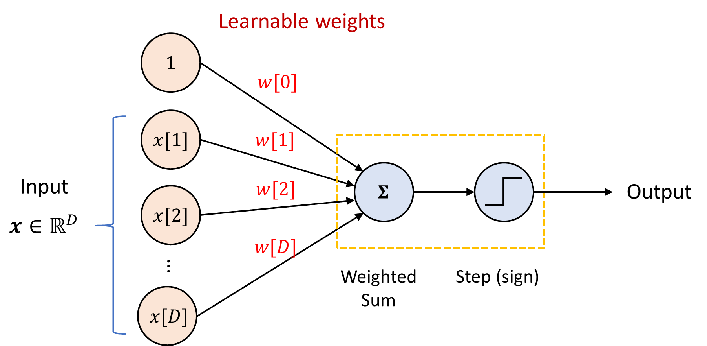
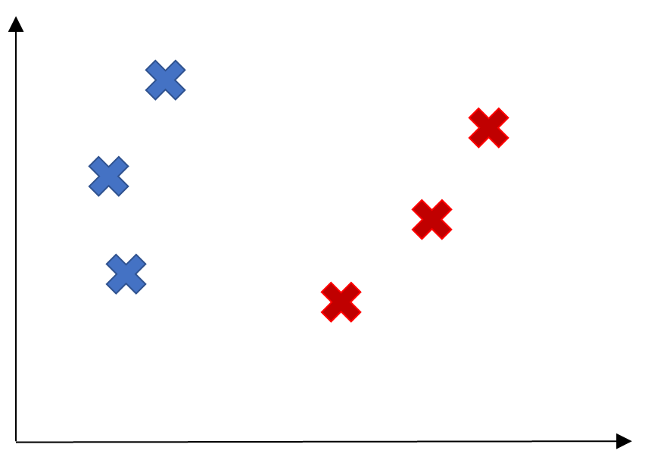
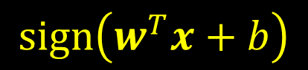
Perceptron Algorithm
An algorithm to learn a perceptron for binary classification
$$sign\left(w^{T}x+b\right)$$

Slide 25
Perceptron Algorithm
Exercise:

Slide 26
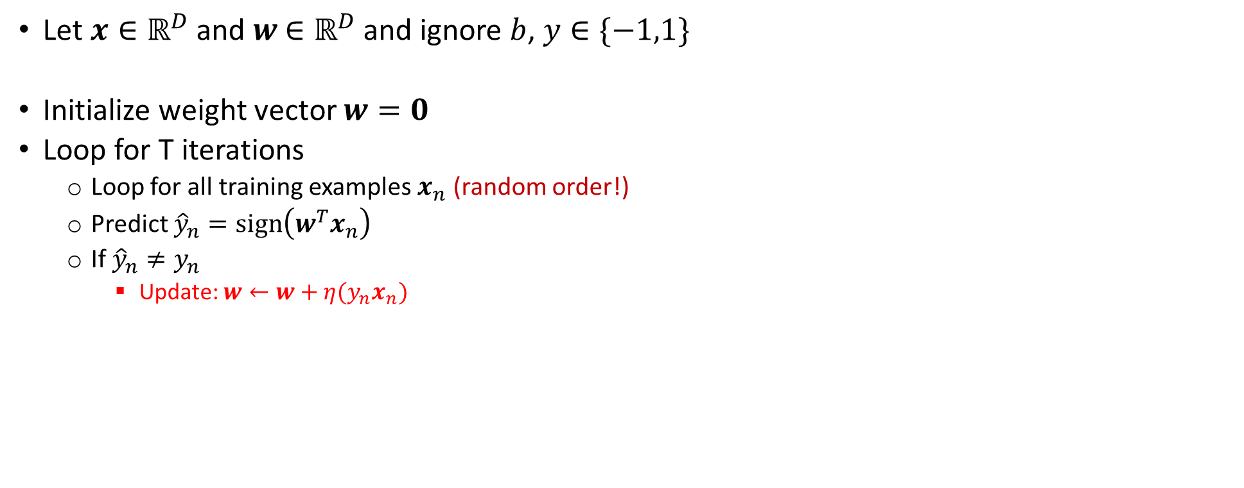
Perceptron Algorithm
Let $x∈ℝ^{D}$ and $w$ $∈ℝ^{D}$ and ignore $b$, $y∈\{−1,1\}$
Initialize weight vector $w=0$
Loop for T iterations
Loop for all training examples $x_{n}$ (random order!)
Predict ${\hat{y}}_{n}=sign\left(w^{T}x_{n}\right)$
If ${\hat{y}}_{n}≠y_{n}$
Update: $w←w+η(y_{n}x_{n})$

Slide 27
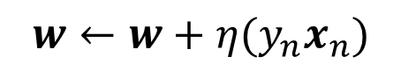
Perceptron Algorithm
Exercise:
+1
$$w←w+η(y_{n}x_{n})$$
-1

Slide 28
Perceptron Algorithm
Example:
+1
$$w←w+η(y_{n}x_{n})$$
-1

Slide 29
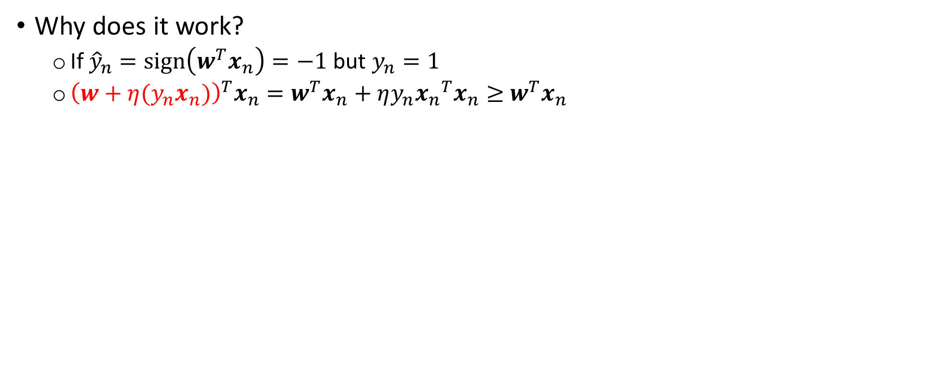
Perceptron Algorithm
Why does it work?
If ${\hat{y}}_{n}=sign\left(w^{T}x_{n}\right)=−1$ but $y_{n}=1$
${\left(w+η(y_{n}x_{n})\right)}^{T}x_{n}=w^{T}x_{n}+ηy_{n}{x_{n}}^{T}x_{n}≥$ $w^{T}x_{n}$

Slide 30
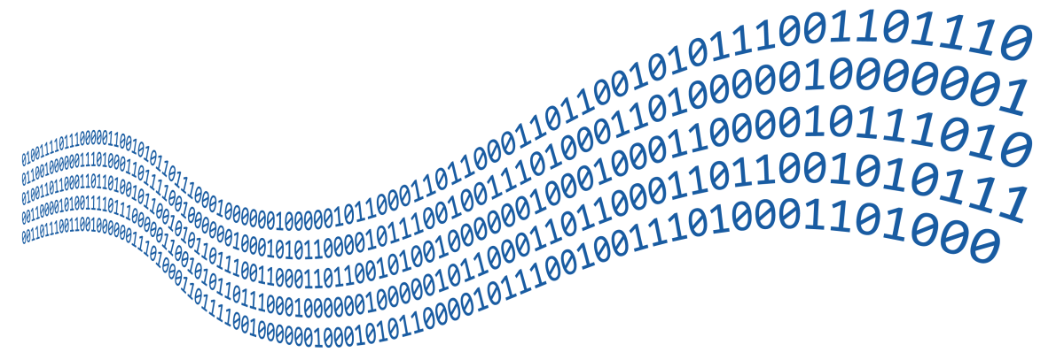
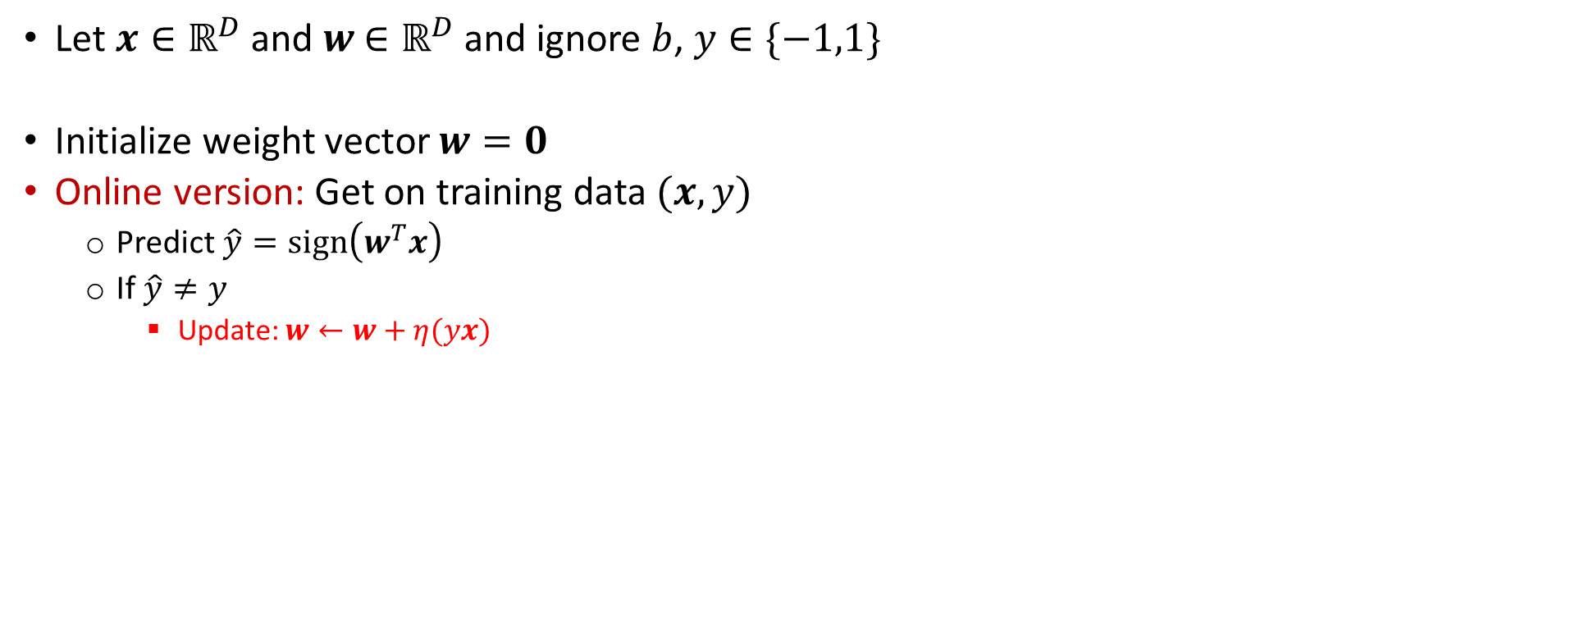
Perceptron Algorithm
Let $x∈ℝ^{D}$ and $w$ $∈ℝ^{D}$ and ignore $b$, $y∈\{−1,1\}$
Initialize weight vector $w=0$
Online version: Get on training data $(x,y)$
Predict$\hat{y}=sign\left(w^{T}x\right)$
If $\hat{y}≠y$
Update: $w←w+η(yx)$

Slide 31
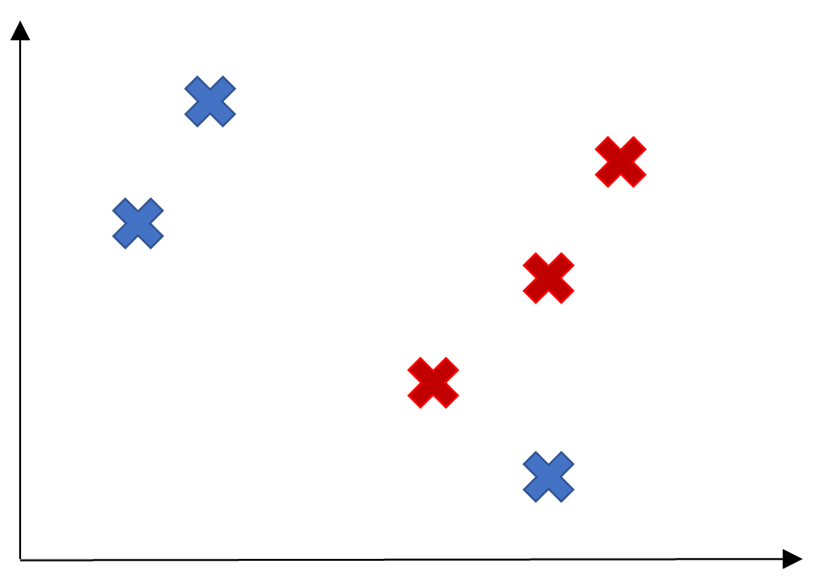
Perceptron Algorithm
Convergence:
If the data is linear separable
Not convergence:
If the data is not linear separable

Slide 32
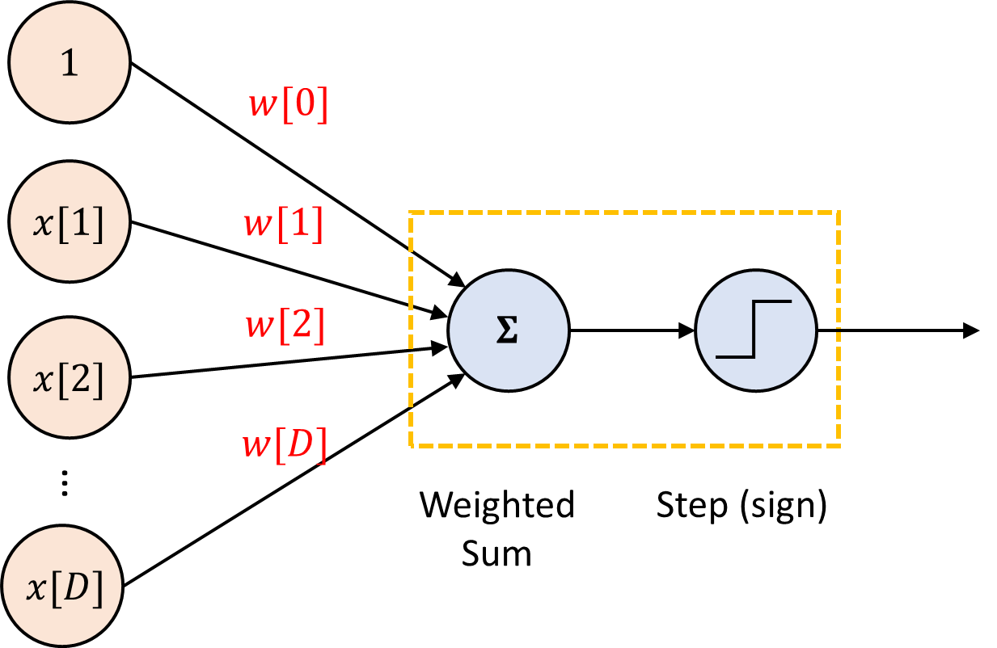

Multi-layer perceptron

Slide 33
Multi-layer perceptron
Learning Perceptron algorithm
Back-propagation
Mini-batch gradient descent

Slide 34
Multi-Layer Perceptron (MLP)

